Slide 1
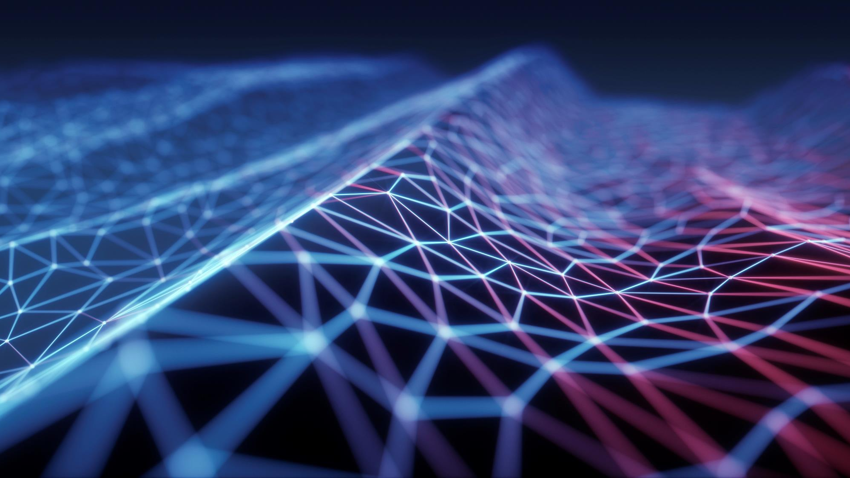

EMG DATA ANALYSIS
#UJEP #KATEDRA INFORMATIKY

Slide 2
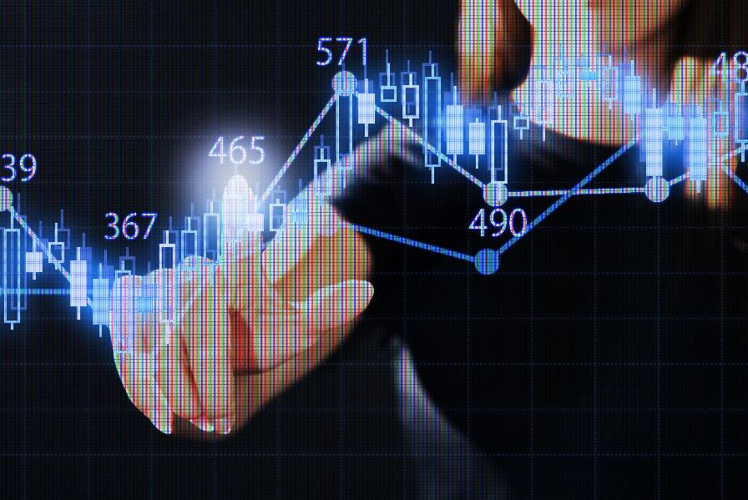

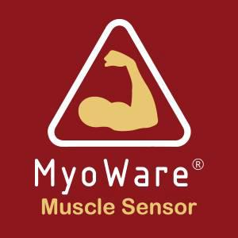

Data harvesting
Raspberry Pi 3 Model B
MYOWARE MUSCLE SENSOR
Arduino Uno – Micro Controller

Slide 3
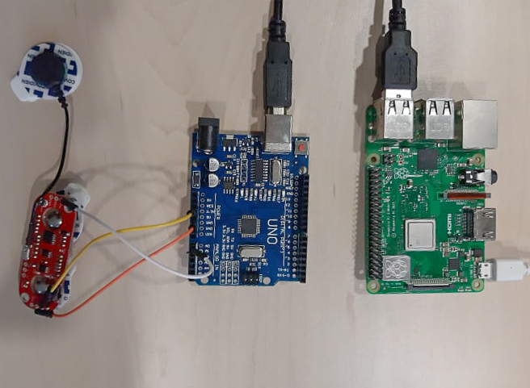
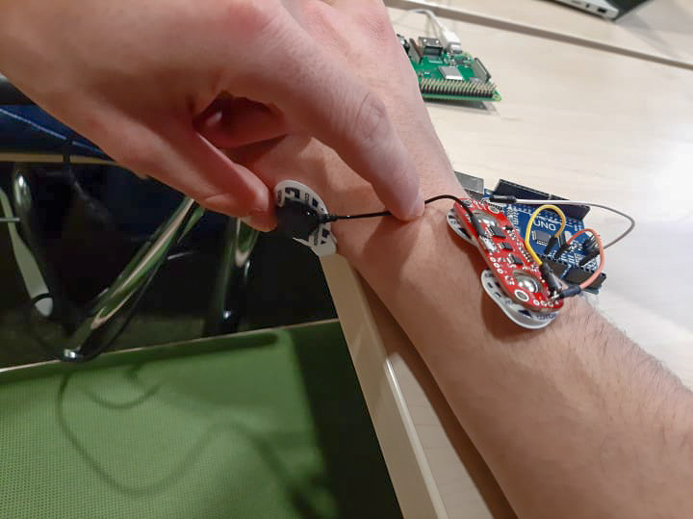
Our set
Set attached to forearm

Slide 4
Our set
This part need to be attached to the bone
(reference sensor)
Muscle sensors

Slide 5
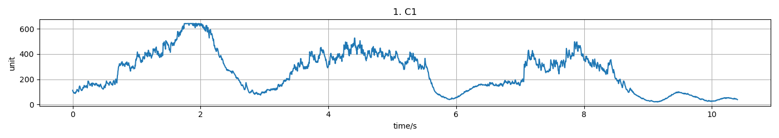
RAW Output of data
Right arm squeezing bottle for three times

Slide 6
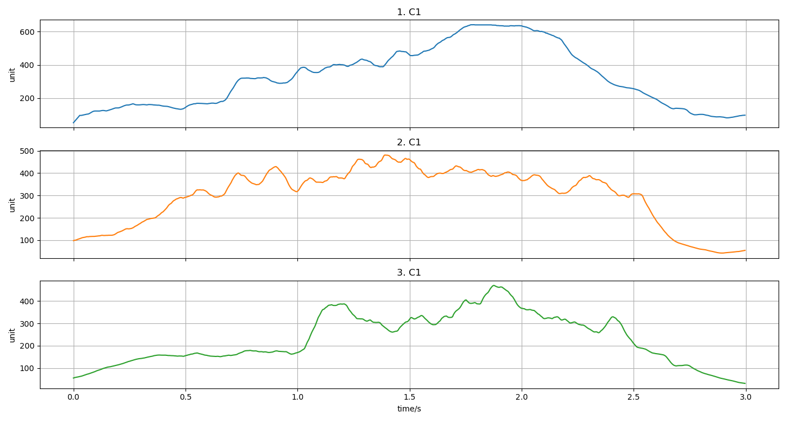
After data processing
Normalized data

Slide 7
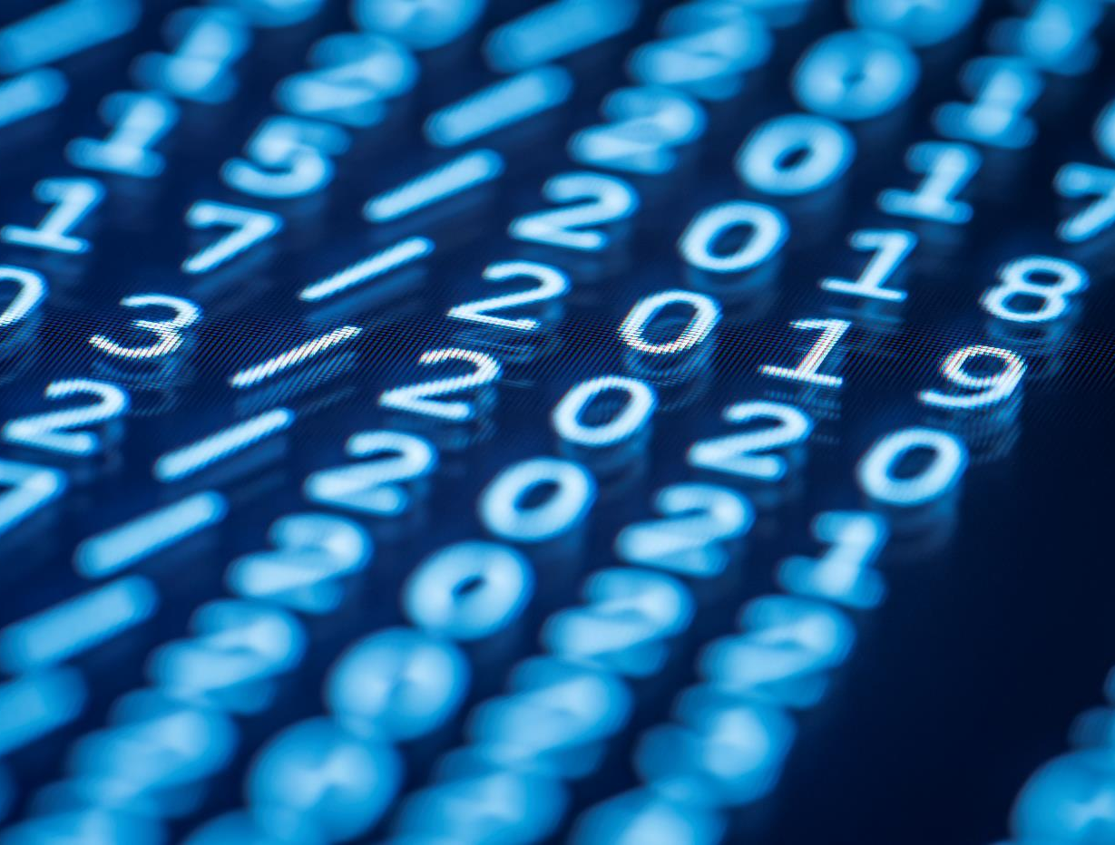

Děkujeme!
Thank you

